Slide 1
Greedy Algorithms (Chap. 16)
Optimization problems
  Dynamic programming, but overkill sometime.
  Greedy algorithm:
    Being greedy for local optimization with the hope it will lead to a global optimal solution, not always, but in many situations, it works.

Slide 2
An Activity-Selection Problem
Suppose A set of activities S={a₁, a₂,…, a_{n}}
  They use resources, such as lecture hall, one lecture at a time
  Each a_{i}, has a start time s_{i}, and finish time f_{i}, with 0≤ s_{i}< f_{i}<∝.
  a_{i} and a_{j} are compatible if [s_{i}, f_{i}) and [s_{j}, f_{j}) do not overlap
Goal: select maximum-size subset of mutually compatible activities.
Start from dynamic programming, then greedy algorithm, see the relation between the two.

Slide 3
DP solution –step 1
Optimal substructure of activity-selection problem.
  Furthermore, assume that f₁ ≤… ≤f_{n}.
  Define S_{ij}={a_{k}: f_{i}≤ s_{k}<f_{k}≤s_{j}}, i.e., all activities starting after a_{i} finished and ended before a_{j} begins.
  Define two fictitious activities a₀ with f₀=0 and a_{n+1} with s_{n+1}=∞
    So f₀ ≤f₁ ≤… ≤f_{n+1}.
  Then an optimal solution including a_{k} to S_{ij} contains within it the optimal solution to S_{ik} and S_{kj}.

Slide 4
DP solution –step 2
A recursive solution
Assume c[n+1,n+1] with c[i,j] is the number of activities in a maximum-size subset of mutually compatible activities in S_{ij}. So the solution is c[0,n+1]=S_{0,n+1}.
C[i,j]= 0 if S_{ij}=∅ max{c[i,k]+c[k,j]+1} if S_{ij}≠∅
      i<k<j and a_{k}∈S_{ij}
How to implement?
  How to compute the initial cases by checking S_{ij}=∅?
  How to loop to iteratively compute C[i,j]:
  For i=… for j=… for k=…? This is wrong?
  Need to be similar to MCM:
    For len=… for i=… j=i+len; for k=…

Slide 5
Converting DP Solution to Greedy Solution
Theorem 16.1: consider any nonempty subproblem S_{ij}, and let a_{m} be the activity in S_{ij} with earliest finish time: f_{m}=min{f_{k} : a_{k} ∈ S_{ij}}, then
Activity a_{m} is used in some maximum-size subset of mutually compatible activities of S_{ij}.
The subproblem S_{im} is empty, so that choosing a_{m} leaves S_{mj} as the only one that may be nonempty.
Proof of the theorem:

Slide 6
Top-Down Rather Than Bottom-Up
To solve S_{ij}, choose a_{m} in S_{ij} with the earliest finish time, then solve S_{mj}, (S_{im} is empty)
It is certain that optimal solution to S_{mj} is in optimal solution to S_{ij}.
No need to solve S_{mj} ahead of S_{ij}.
Subproblem pattern: S_{i,n+1}.

Slide 7
Optimal Solution Properties
In DP, optimal solution depends:
  How many subproblems to divide. (2 subproblems)
  How many choices to determine which subproblem to use. (j-i-1 choices)
However, the above theorem (16.1) reduces both significantly
  One subproblem (the other is sure to be empty).
  One choice, i.e., the one with earliest finish time in S_{ij}.
  Moreover, top-down solving, rather than bottom-up in DP.
  Pattern to the subproblems that we solve, S_{m,n+1} from S_{ij}.
  Pattern to the activities that we choose. The activity with earliest finish time.
  With this local optimal, it is in fact the global optimal.

Slide 8
Elements of greedy strategy
Determine the optimal substructure
Develop the recursive solution
Prove one of the optimal choices is the greedy choice yet safe
Show that all but one of subproblems are empty after greedy choice
Develop a recursive algorithm that implements the greedy strategy
Convert the recursive algorithm to an iterative one.

Slide 9
Greedy vs. DP
Knapsack problem
  I1 (v1,w1), I2(v2,w2),…,In(vn,wn).
  Given a weight W at most he can carry,
  Find the items which maximize the values
Fractional knapsack,
  Greed algorithm, O(nlogn)
0/1 knapsack.
  DP, O(nW).
  https://www.youtube.com/watch?v=8LusJS5-AGo
  http://techieme.in/solving-01-knapsack-problem-using-dynamic-programming/

Slide 10
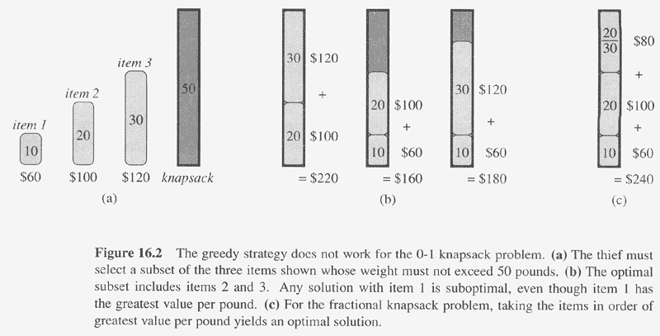
Copyright © The McGraw-Hill Companies, Inc. Permission required for reproduction or display.

Slide 11
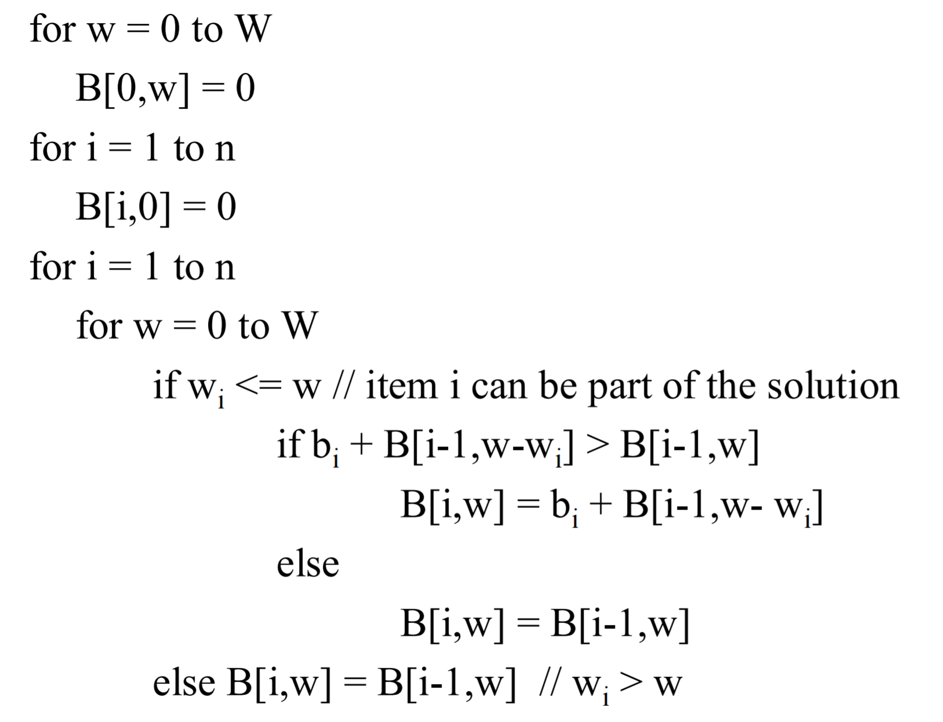
0/1 Knapsack problem solution
https://www.youtube.com/watch?v=8LusJS5-AGo

Slide 12
Typical tradition problem with greedy solutions
Coin changes
  25, 10, 5, 1
  How about 7, 5, 1
Minimum Spanning Tree
  Prim’s algorithm
    Begin from any node, each time add a new node which is closest to the existing subtree.
  Kruskal’s algorithm
    Sorting the edges by their weights
    Each time, add the next edge which will not create cycle after added.
Single source shortest pathes
  Dijkstra’s algorithm
Huffman coding
Optimal merge

